Slide 1
Media Public
A public intranet for public media

Slide 2
Background
In 2015, Melody Kramer took a three-month sabbatical from her day job and went to Harvard, where she researched different ways that public media stations could be strengthened by working more closely with other stations and the public.
As part of her research, she interviewed dozens of people from inside of public media. They said things like:
"I want to share what I learn with other stations and the public but I don't have a good place to do that."
"I would totally share stories from other stations, but I can't find the best of what public media publishes on a daily basis and I don't have time to go to every other station website."
"We'd love to have the public help us build or code tools, but we can't organize that through email. It would be overwhelming."

Slide 3
People wanted to share information, tools, and stories with each other and the public — but didn't have the tools to collaborate and communicate with each other or the public. We’re building a collaborative platform to make that collaborative vision happen. It’s a “public intranet for public media” that we call Media Public.

Slide 4
Our vision
There are almost 1000 public media stations in the US. Some of them are big and some of them are small, but all of them serve their local communities with a really great and public service.

Slide 5
Our vision
There are almost 1000 public media stations in the US. Some of them are big and some of them are small, but all of them serve their local communities with a really great and public service.
MediaPublic helps stations, large and small, by promoting the sharing of knowledge, experience, and best practices while bringing the content that those stations create together all in one place.

Slide 6
Our vision
There are almost 1000 public media stations in the US. Some of them are big and some of them are small, but all of them serve their local communities with a really great and public service.
MediaPublic helps stations, large and small, by promoting the sharing of knowledge, experience, and best practices while bringing the content that those stations create together all in one place.
We will invite members from all stations to share their experiences on what they believe is the best way to bring such a valuable service to their local communities with the MediaPublic platform.

Slide 7
Our vision
There are almost 1000 public media stations in the US. Some of them are big and some of them are small, but all of them serve their local communities with a really great and public service.
MediaPublic helps stations, large and small, by promoting the sharing of knowledge, experience, and best practices while bringing the content that those stations create together all in one place.
We will invite members from all stations to share their experiences on what they believe is the best way to bring such a valuable service to their local communities with the MediaPublic platform.
We want MediaPublic to be the one-stop-shop for those inside and outside of Public Media.

Slide 8
A communal place
Media Public will be a place where public media organizations can:
Easily find who is working in public media
Collaborate and share with each other and the public
Easily showcase stories that transcend geographic borders
Ask the public and other stations for help in specific, guided ways.

Slide 9
A communal place
Media Public will be a place where public media organizations can:
Easily find who is working in public media
Collaborate and share with each other and the public
Easily showcase stories that transcend geographic borders
Ask the public and other stations for help in specific, guided ways.
Media Public will be a place where the public can:
Help public media stations or shows with specific tasks
Listen to stories that they might have not found otherwise
Find out storytelling and engagement techniques from stations around the country
Easily find out who is working in public media and how to contact them.

Slide 10
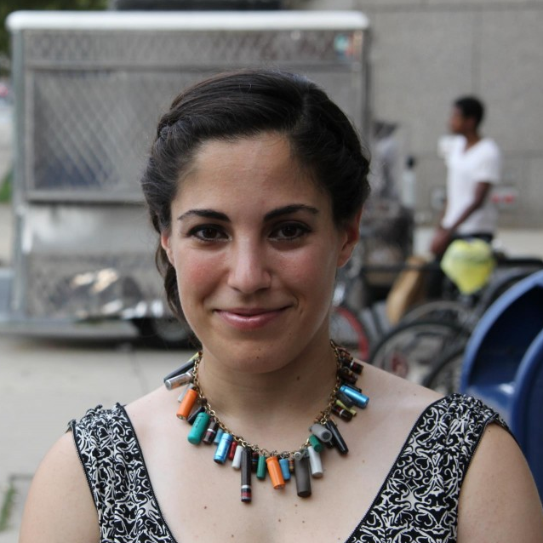
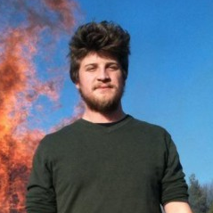
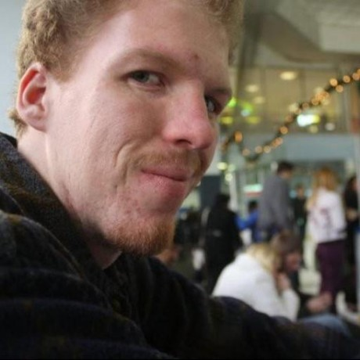
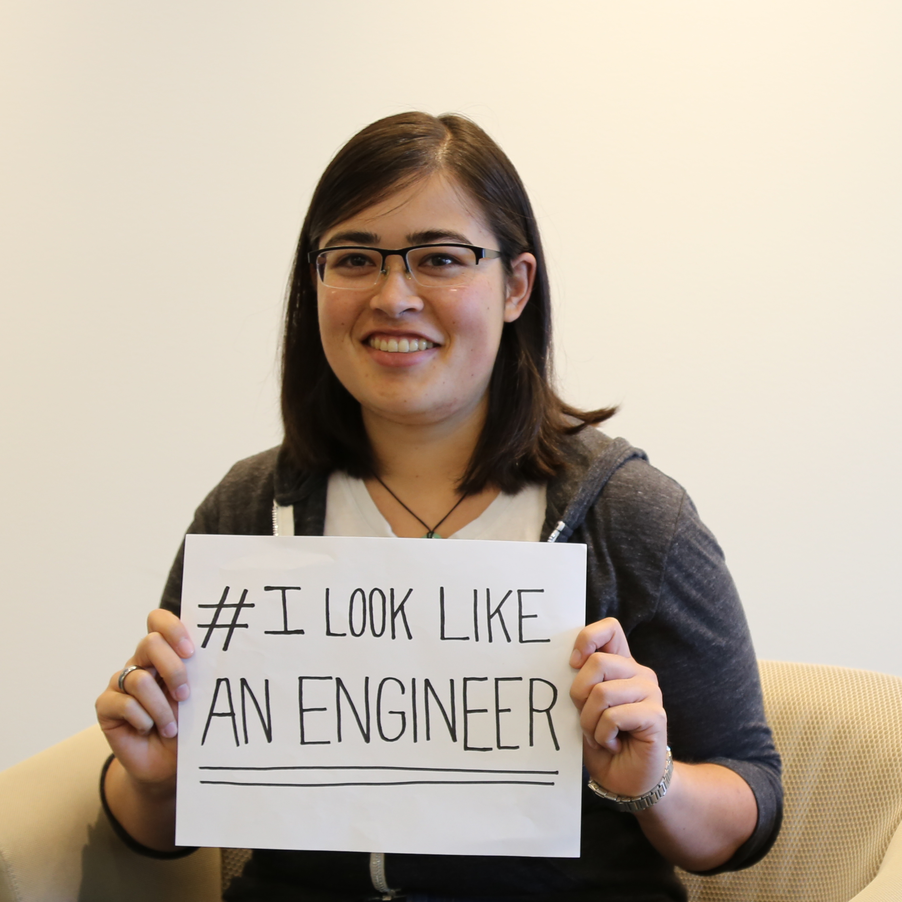
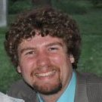

The Team
Melody Kramer
Product, Content
Gabe Isman
Developer
Ryan Brown
Developer
Nikki Lee
Product Designer
Tim Duffy
Developer
Isaac Moldofsky
Developer

Slide 11
How we found each other
I reached out the way I normally do: online! And it worked!

Slide 12
How we found each other
Melody wrote a blog post about this cool idea to help public media stations. I wanted to help.

Slide 13
How we found each other
Helped with one of Tim’s other civic projects and joined to build this one.

Slide 14
How we found each other
Melody tweeted about working on a new project. I was home sick and asked if she needed extra hands.

Slide 15
How we found each other
Melody put out a tweet about “needing 500 volunteers stat”. I couldn’t resist to find out more.

Slide 16
How we found each other
I was asking Melody about ideas and she told me about this project.

Slide 17
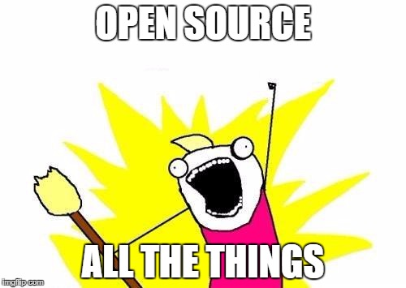
What’s unique about our process
Notes:
Open Source all the things! [ insert meme here ]

Slide 18
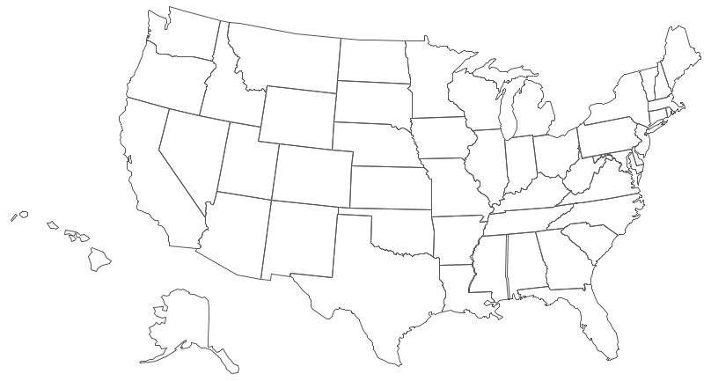

What’s unique about our process
Notes:
Our team is distributed ( many of us have never met in person! )
We use Github, Google Hangouts, and email to communicate

Slide 19

What’s unique about our process
Notes:
We use Github to track all our work, review code, and share the finished product.

Slide 20


What’s unique about our process
+
Notes:
We tried the “let’s set up two week sprints” thing. We kind of did it, but really it was all about closing tickets when developers had bandwidth.
We separated stuff as much as possible in our architecture to minimize developers blocking each other. Not perfect, but the team thinks we did okay.
We worked publicly and the public has watched us work (and made our work better.)

Slide 21
What we’ve been working on
1. A functional website!
2. Communication with stations and the public
3. A newsletter to keep people up to date
4. Hooks to bring the public in - and keep them intrigued

Slide 22
Parts of the site
Home Page
Orgs
Requests
People
How Tos
Podcasts
Notes:
Homepage: Site-wide search and various bits of information about the site
Organizations: Landing page for every station ( organization ). Has all the info you would want right on the landing page of how to get involved, list of people, podcasts, help requests, and howtos.
People: The people of Public Media!
Podcasts: All of the podcasts of Public Media, and links to their landing pages ( off-site )
Help Requests: “We need this thing, if you can help us we’ll give you membership!”
Howtos: “We did this thing that was really successful, and we want you to be successful with it too!”

Slide 23
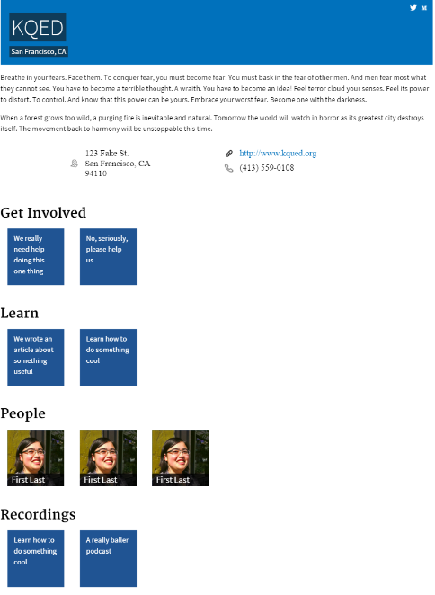
Organizations Page
Help Requests
A way for stations to ask for volunteers and support.
How Tos
A way for stations to share knowledge.
People
All the people at the station and what they do.
Recordings
Podcasts and other media that the station produces.
Notes:
A core part of the site is the organization landing page. This page holds information about the station itself, as well as all of the information on the site that is associated with the station.
Help Requests: This allows a station to post request for help to MediaPublic. Then users can respond to those requests as volunteers or help point the station in the correct direction for support.
Howtos: This is a collection of all the howtos that people at the station have written.
People: List of all the people at the station and their function. Primarily focusing on content creators ( but certainly not limited to it )
Podcasts: A list of all the podcasts ( and in the future the actual recordings ) that the station produces

Slide 24
Howtos

Slide 25
Help Requests

Slide 26
Demo
[ do demo ??? video ??? probably video. TODO: make video of how to use the site ]

Slide 27
More than 15 public media stations have expressed interest in using the platform once it goes live. We've also talked to government agencies who are interested in adapting the platform for sharing information about their products with the public. We see the platform as useful for anyone working in the public sector - but started with the use case that we know best.

Slide 29
Appendix

Slide 30
Stretch goals ( that we didn’t hit )
Bookmarklet Lets any user quickly share new content from a station back to the MediaPublic website
Pulling in all Podcast recordings Would be great if we could pull in all recordings to the site
Playlists Have users be able to make playlists of those recordings, and then share them
Blog We actually did hit this goal, but we’re doing it with TinyLetter
More people! The best part about Public Media is the people! We’d like to continue to reach out, and bring more people from inside and outside of Public Media into the fold.

